Slide 1
Lecture 2
Least squares fitting

Slide 2
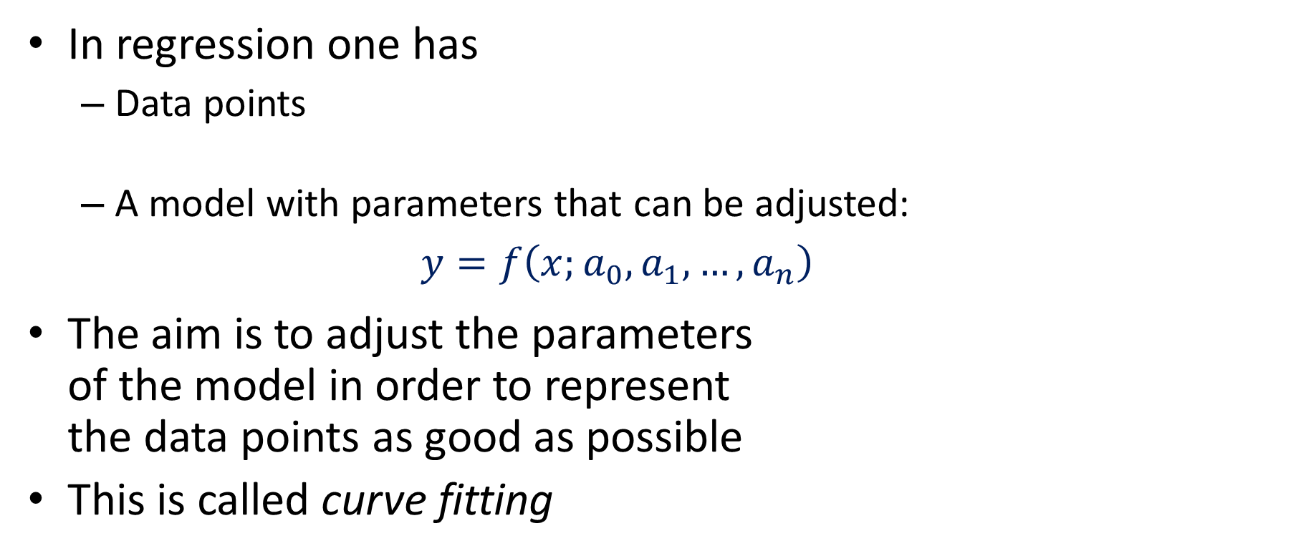


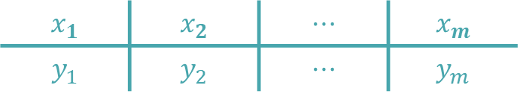
Overview of Regression
In regression one has
Data points
A model with parameters that can be adjusted: $y=f\left(x;a_{0},a_{1},…,a_{n}\right)$
The aim is to adjust the parameters of the model in order to represent the data points as good as possible
This is called curve fitting
$$x_{1}$$ | $$x_{2}$$ | $$⋯$$ | $$x_{m}$$
$$y_{1}$$ | $$y_{2}$$ | $$⋯$$ | $$y_{m}$$
$$y_{i}$$
$$x_{i}$$
Notes:
We start this lecture by giving an overview of regression.
As we discussed in the previously, in regression we have:
A data set made out of data points
And a model which is a mathematical function having some parameters we can freely choose
The aim is to adjust the parameters of the model in order to represent the data points as good as possible
This is often referred to as curve fitting
Take a moment to familiarize yourself with the notations
The data points are denoted xi, yi and numbered from1 to m.
That means we have m data points.
The parameters of the model are denoted ai and numbered from 0 to n.
That means we have n+1 parameters.
Pay particular attention on how the data points and model parameters are numbered
Not all textbooks or references number them the same way as we did
For example, some will start numbering the data points in 0
This doesn’t seem to be a big deal, but when you compare formulas you will realize that they differe depending on how the points, or model parameters are numbered.

Slide 3

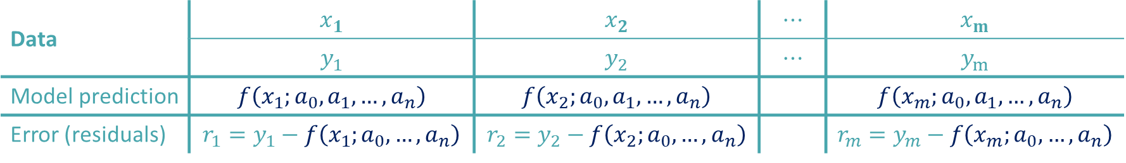
How to measure if a model fits or not
One introduces a measure for the error between the model prediction and the available data points
$${r_{i}=y}_{i}−f\left(x_{i};a_{0}, …,a_{n}\right)$$
Data | $$x_{1}$$ | $$x_{2}$$ | $$⋯$$ | $$x_{m}$$
 | $$y_{1}$$ | $$y_{2}$$ | $$⋯$$ | $$y_{m}$$
Model prediction | $$f\left(x_{1};a_{0},a_{1},…,a_{n}\right)$$ | $$f\left(x_{2};a_{0},a_{1},…,a_{n}\right)$$ |  | $$f\left(x_{m};a_{0},a_{1},…,a_{n}\right)$$
Error (residuals) | $${r_{1}=y}_{1}−f\left(x_{1};a_{0}, …,a_{n}\right)$$ | $${r_{2}=y}_{2}−f\left(x_{2};a_{0}, …,a_{n}\right)$$ |  | $${r_{m}=y}_{m}−f\left(x_{m};a_{0}, …,a_{n}\right)$$
Notes:
How will we adjust the model to the data set ?
The idea is to measure the error between the model prediction and the data points.
In a second phase we will minimize this error by choosing correctly the parameters.
Let us work out all this in a table
First of all we have our data
We have the points (x1, y1), (x2, y2) and so on until (xm, ym)
Then we have the model prediction.
Imagine for an instant we did choose some parameters a0 to an.
Having chosen these parameters we can, for each data point xi, compute the corresponding prediction y by the model
For example for the data point x1 we would get as prediction f(x1) with the parameters a0 to an fixed according our choice.
Same way we get a prediction f(x2) for the data point x2 and so on
We can now compare these predictions with the actual data points.
For the first data point we can calculate the difference r1 between the actual data point y1 and it’s prediction by the model
We can proceed similarly with the second point
Until the last one
These differences are called residuals and their general formula is:
${r_{i}=y}_{i}−f\left(x_{i};a_{0}, …,a_{n}\right)$

Slide 4
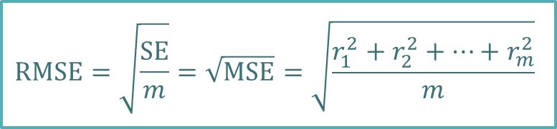
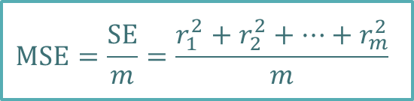


Measuring the Size of the Residuals
Residuals are a function of the model parameters.
A different set of model parameters gets different residuals
Aim: choose model parameters to minimize these residuals
How do we measure the size of residuals?
Vector norms
Examples
Squared error: Mean squared error: Root mean squared error
$${r_{i}=y}_{i}−f\left(x_{i};a_{0}, …,a_{n}\right)$$
$$SE=r_{1}^{2}+r_{2}^{2}+…+r_{m}^{2}$$
$$\text{MSE}=\frac{\text{SE}}{m}=\frac{r_{1}^{2}+r_{2}^{2}+…+r_{m}^{2}}{m}$$
All these measures can be seen as functions of the model parameters.
$$\text{RMSE}=\sqrt{\frac{\text{SE}}{m}}=\sqrt{\text{MSE}}=\sqrt{\frac{r_{1}^{2}+r_{2}^{2}+…+r_{m}^{2}}{m}}$$
Notes:
Now we know how to compare the model prediction and the data points by computing for each points the residual ri
Note that the residuals are a function of the model parameters
Whenever we choose a different set of model parameters we will get different residuals
Our aim will be to choose model parameters such as to minimize these residuals.
How do we measure the size of these residuals?
We can use vector norms
For example we can use the Euclidian norm which will allow us to define the squared error.
The squared error SE will be equal to the sum of all residuals squared.
If one divides by the number of points, one obtains the mean squared error MSE
If further one takes the square root, one obtains the root mean squared error RMSE
Note that the root mean square error measures how far away are the model predictions form the data points in average.
It is a very popular measure for quickly asses how good a model will represents the data set.
An important pint to realize is that all these measures can be seen as functions of the model parameters.
Indeed, for a given dataset, whenever we choose a different set of parameters these measure will change.
Let us illustrate this with an example

Slide 5
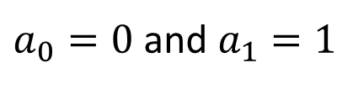
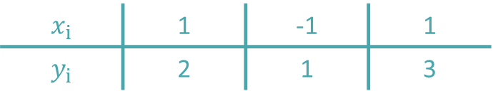
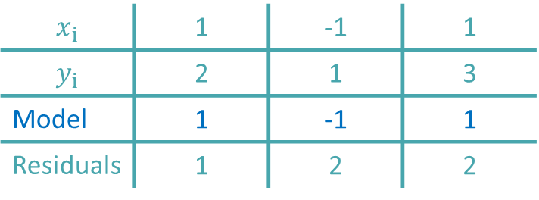
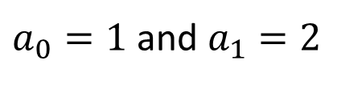
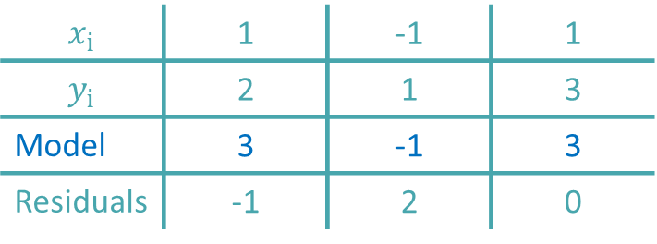



Example
Consider the following data points and model
$$x_{i}$$ | 1 | -1 | 1
$$y_{i}$$ | 2 | 1 | 3
$${y=a}_{0}+a_{1}x$$
$a_{0}=1$ and $a_{1}=2$
$a_{0}=0$ and $a_{1}=1$
$$x_{i}$$ | 1 | -1 | 1
$$y_{i}$$ | 2 | 1 | 3
Model | 3 | -1 | 3
Residuals | -1 | 2 | 0
$$x_{i}$$ | 1 | -1 | 1
$$y_{i}$$ | 2 | 1 | 3
Model | 1 | -1 | 1
Residuals | 1 | 2 | 2
$$\text{SE}\left(1,2\right)={\left(−1\right)}^{2}+2^{2}+0^{2}=3$$
$$\text{SE}\left(0,1\right)=1^{2}+2^{2}+2^{2}=9$$
Notes:
Let us consider some data points and a linear model
We will now choose some values for our two model parameters ao and a1 and determine the residuals and squared error that results.
As a first example, let us choose $a_{0}=1$ and $a_{1}=2$
This allow us to fill out our table with the model predication and residual calculation
For example for the first data point our model will predict 1+2*1=3
The residual will be the data point minus the prediction, which is 2-3 yielding -1
In the same way we can compute the prediction and residuals for the remaining data points
Applying the definition for the squared error we obtain 3
Let us now repeat the same exercise for another choice of the model parameters.
This time we choose $a_{0}=0$ and $a_{1}=1$
Again we can compute model predictions and residuals for each data point
This time, the squared error is equal to 9
This example shows how the squared error, or any other measure for the error, will change as we chose different model parameters.
In our case we can say that the first choice of model parameters represents better the data set than the second choice.

Slide 6


Example
$$y=1+2x$$
A much better fit
$$y=x$$
Notes:
It is useful to have a graphical representation of our example.
[axes+points]
Let us first plot our three data points in a coordinate system
[line 1]
The first choice of the model parameters yields to the model y=1+2x, which is a line on our figure
[line 2]
The second choice we did was the model y=x which gives us a second line.
Comparing the two models, we reach the same conclusion as when we calculated the squared error.
The first line represents better the data points than the second line.
However it is as well obvious none of the two lines represent these three points in a good way.
[pulse green line]
There is certainly a better line to fit our data set.
An appropriate methodology should allow us to find this line.
The proper formulation of this methodology is our next target.

Slide 7
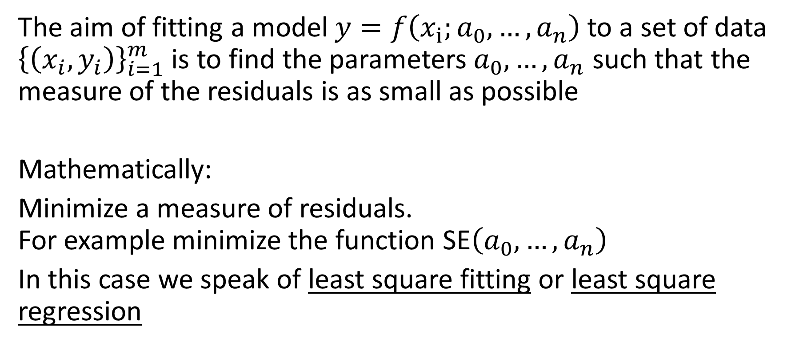
Fitting models to data
The aim of fitting a model $y=f\left(x_{i};a_{0}, …,a_{n}\right)$ to a set of data ${\left\{\left(x_{i},y_{i}\right)\right\}}_{i=1}^{m}$ is to find the parameters $a_{0}, …,a_{n}$ such that the measure of the residuals is as small as possible
Mathematically:
Minimize a measure of residuals. For example minimize the function SE$\left(a_{0}, …,a_{n}\right)$
In this case we speak of least square fitting or least square regression
Notes:
The aim of fitting a model to a set of data is to find the parameters $a_{0}$ to $a_{n}$ such that the measure of the residuals is as small as possible
Mathematically this translates into an optimization problem.
One wants to minimize a measure of residuals, for example minimize the function SE$\left(a_{0}, …,a_{n}\right)$
When the squared error SE is minimized to adjust a model one calls the fitting problem least square fitting or least square regression

Slide 8
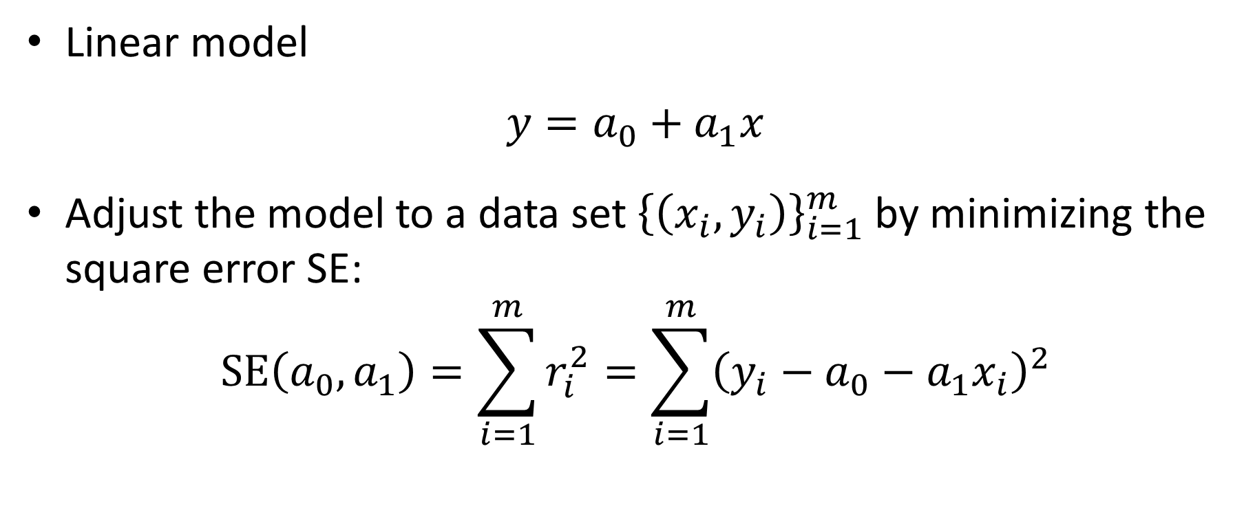
Linear regression
Linear model
$${y=a}_{0}+a_{1}x$$
Adjust the model to a data set ${\left\{\left(x_{i},y_{i}\right)\right\}}_{i=1}^{m}$ by minimizing the square error SE:
$$\text{SE}\left(a_{0},a_{1}\right)=\sum_{i=1}^{m}{r_{i}^{2}}=\sum_{i=1}^{m}{{\left(y_{i}−a_{0}−a_{1}x_{i}\right)}^{2}}$$
Notes:
Let us apply this methodology for a linear model ${y=a}_{0}+a_{1}x$
Our task is to minimize the squared error for the given data set of m data points.
The squared error is the sum of the square of all residuals which is the sum over ${\left(y_{i}−a_{0}−a_{1}x_{i}\right)}^{2}$

Slide 9
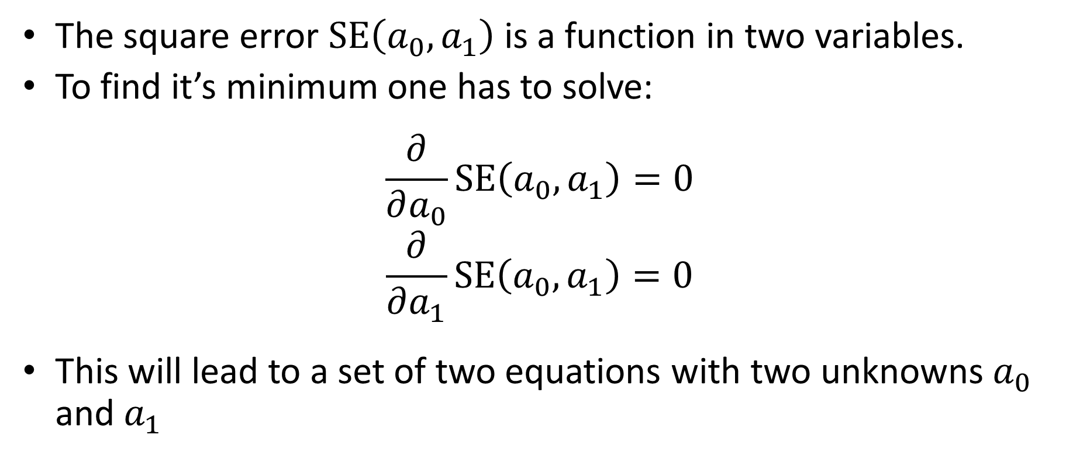
Linear regression
The square error $\text{SE}\left(a_{0},a_{1}\right)$ is a function in two variables.
To find it’s minimum one has to solve:
$$\frac{∂}{∂a_{0}}\text{SE}\left(a_{0},a_{1}\right)=0$$
$$\frac{∂}{∂a_{1}}\text{SE}\left(a_{0},a_{1}\right)=0$$
This will lead to a set of two equations with two unknowns $a_{0}$ and $a_{1}$
Notes:
As we have two model parameters, the square error is a function in two variables
To find the minimum we have to solve the two equations
$$\frac{∂}{∂a_{0}}\text{SE}\left(a_{0},a_{1}\right)=0$$
and $\frac{∂}{∂a_{1}}\text{SE}\left(a_{0},a_{1}\right)=0$
Solving these equations will give us the values of the parameters $a_{0}$ and $a_{1}$ which will minimize the squared error.

Slide 10
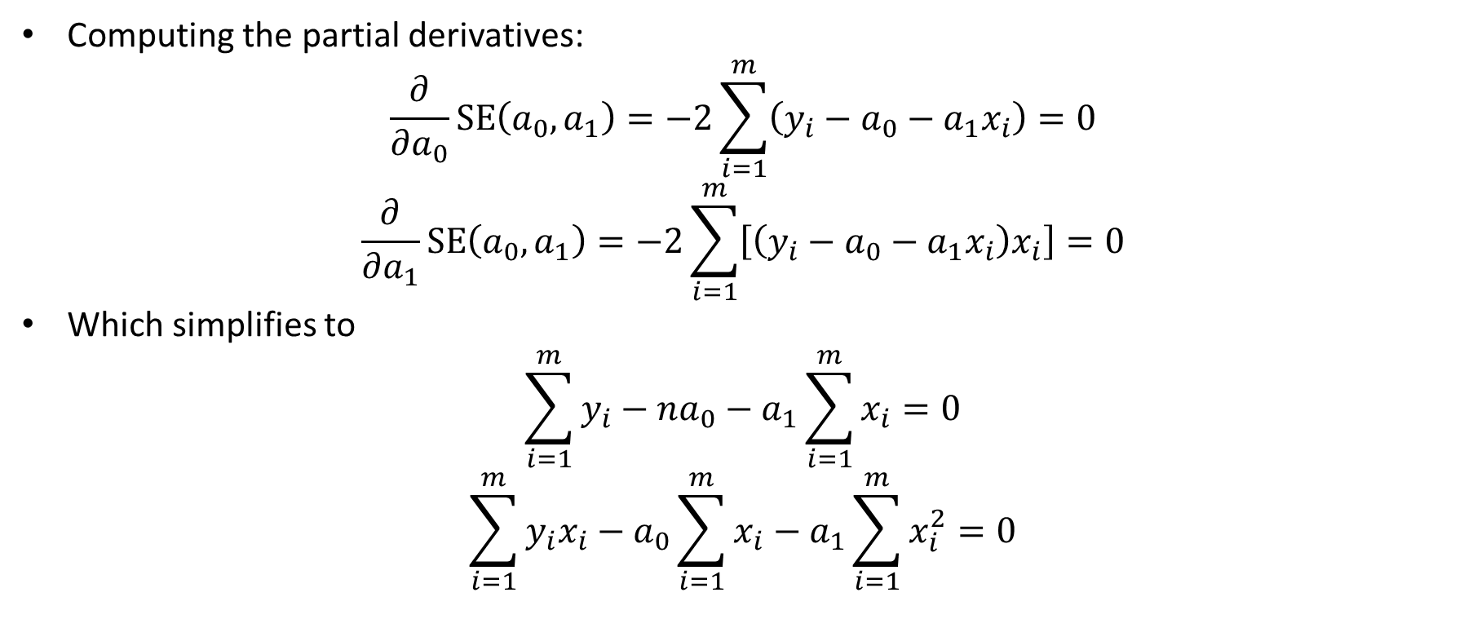
Linear regression
Computing the partial derivatives:
$$\frac{∂}{∂a_{0}}\text{SE}\left(a_{0},a_{1}\right)=−2\sum_{i=1}^{m}{\left(y_{i}−a_{0}−a_{1}x_{i}\right)}=0$$
$$\frac{∂}{∂a_{1}}\text{SE}\left(a_{0},a_{1}\right)=−2\sum_{i=1}^{m}{\left[\left(y_{i}−a_{0}−a_{1}x_{i}\right)x_{i}\right]}=0$$
Which simplifies to
$$\sum_{i=1}^{m}{y_{i}}−na_{0}−a_{1}\sum_{i=1}^{m}{x_{i}=0}$$
$$\sum_{i=1}^{m}{y_{i}x_{i}}−a_{0}\sum_{i=1}^{m}{x_{i}−a_{1}\sum_{i=1}^{m}{x_{i}^{2}}=0}$$
Notes:
The calculations are a little lengthy but not really difficult
First we calculate the two partial derivatives
Afterwards we simplify algebraically the two equations to finally obtain a linear system of two equations for the two unknowns $a_{0}$ and $a_{1}$

Slide 11

Linear regression
Solving the linear system of two equations:
$$a_{1}=\frac{m\sum_{i=1}^{m}{x_{i}y_{i}}−\sum_{i=1}^{m}{x_{i}}\sum_{i=1}^{m}{y_{i}}}{m\sum_{i=1}^{m}{x_{i}^{2}}−{\left(\sum_{i=1}^{m}{x_{i}}\right)}^{2}}$$
$$a_{0}=\frac{1}{m}\sum_{i=1}^{m}{y_{i}−a_{1}\frac{1}{m}\sum_{i=1}^{m}{x_{i}}}$$
Notes:
Solving the linear system of two equations gives us the searched values for $a_{0}$ and $a_{1}$
Note that m is the number of data points
This because we numbered the data points from 1 to m
If you number the data points from 0 to m, as some authors do, the formula will differ.

Slide 12
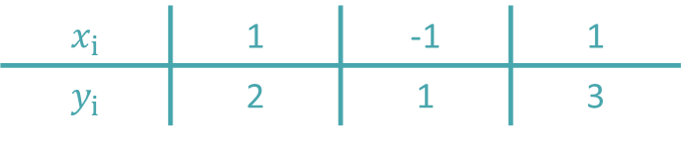
Example
Fit the following data points with a linear equation
$$x_{i}$$ | 1 | -1 | 1
$$y_{i}$$ | 2 | 1 | 3
Notes:
Let us try out our method on an example
Consider a set of three data points and a linear model.
From the graph you can already guess how should look the line that fits best to the data points.
Note that on purpose we did not write down the data points in a particular order
Our methodology doesn’t require that, for example, the points are organized in increasing x values.

Slide 13
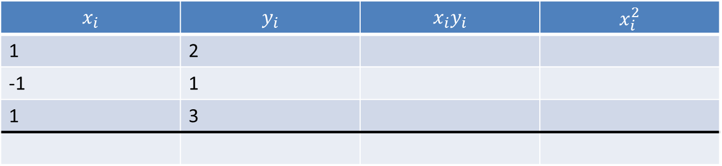
Example
We organize our calculations in a table
$$x_{i}$$ | $$y_{i}$$ | $$x_{i}y_{i}$$ | $$x_{i}^{2}$$
1 | 2
-1 | 1
1 | 3
Notes:
We will organize our calculations in a table
In the first two columns we write down our data points

Slide 14
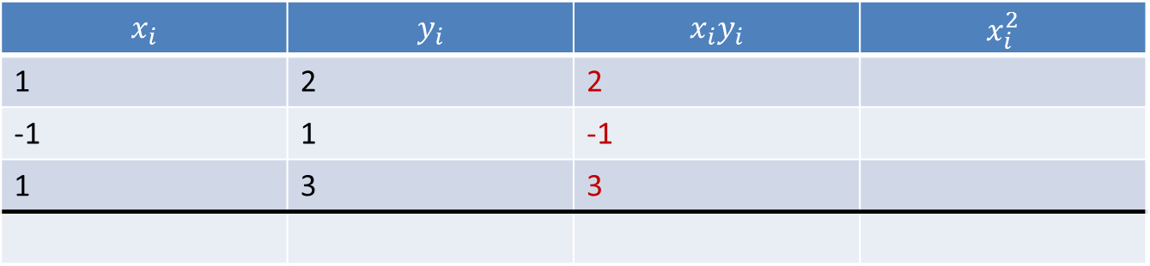
Example
We organize our calculations in a table
$$x_{i}$$ | $$y_{i}$$ | $$x_{i}y_{i}$$ | $$x_{i}^{2}$$
1 | 2 | 2
-1 | 1 | -1
1 | 3 | 3
Notes:
In the next column we write down the products xi times yi

Slide 15
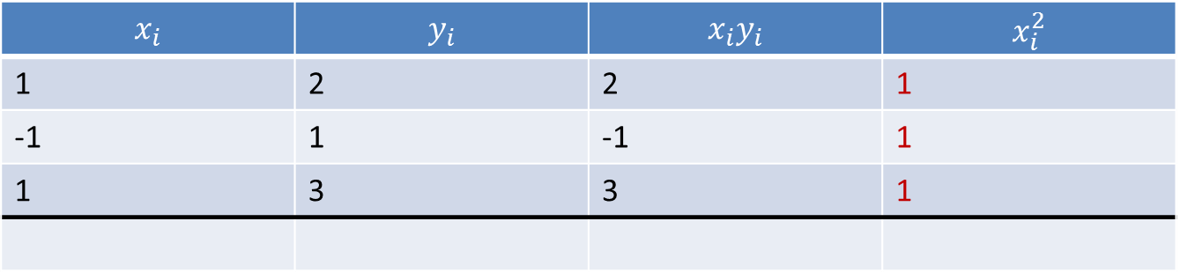
Example
We organize our calculations in a table
$$x_{i}$$ | $$y_{i}$$ | $$x_{i}y_{i}$$ | $$x_{i}^{2}$$
1 | 2 | 2 | 1
-1 | 1 | -1 | 1
1 | 3 | 3 | 1
Notes:
And in the last column the square of the xi.

Slide 16
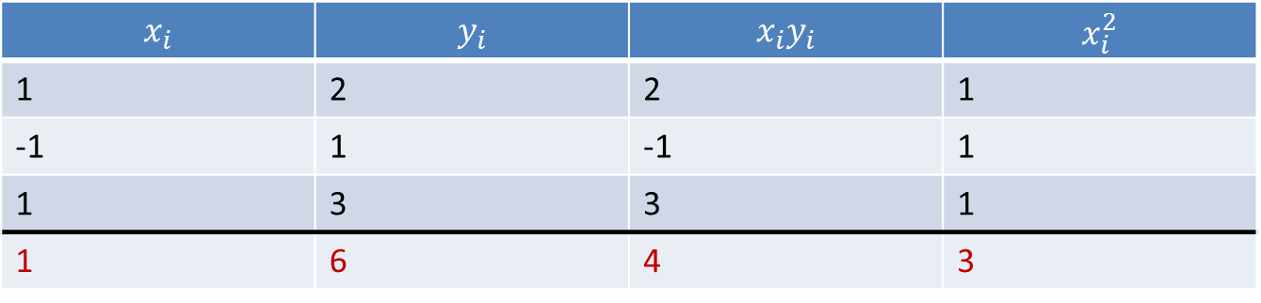
Example
We organize our calculations in a table
$$x_{i}$$ | $$y_{i}$$ | $$x_{i}y_{i}$$ | $$x_{i}^{2}$$
1 | 2 | 2 | 1
-1 | 1 | -1 | 1
1 | 3 | 3 | 1
1 | 6 | 4 | 3
Notes:
We sum each column and report the value in the table

Slide 17
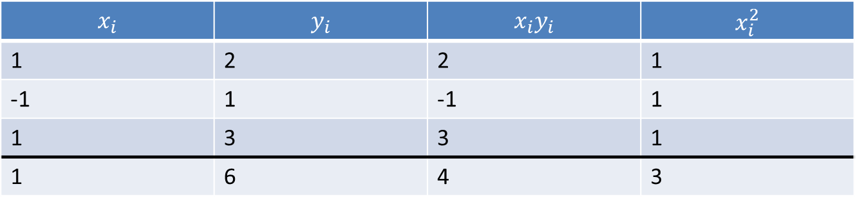
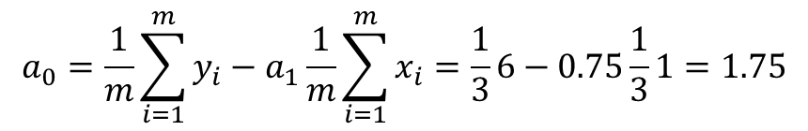
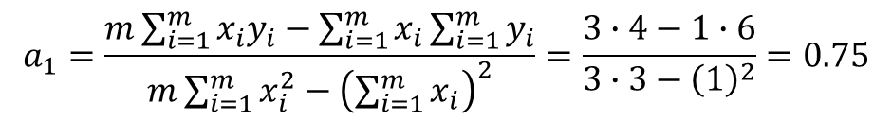
Example
We organize our calculations in a table
$$x_{i}$$ | $$y_{i}$$ | $$x_{i}y_{i}$$ | $$x_{i}^{2}$$
1 | 2 | 2 | 1
-1 | 1 | -1 | 1
1 | 3 | 3 | 1
1 | 6 | 4 | 3
$$a_{1}=\frac{m\sum_{i=1}^{m}{x_{i}y_{i}}−\sum_{i=1}^{m}{x_{i}}\sum_{i=1}^{m}{y_{i}}}{m\sum_{i=1}^{m}{x_{i}^{2}}−{\left(\sum_{i=1}^{m}{x_{i}}\right)}^{2}}=\frac{3∙4−1∙6}{3∙3−{\left(1\right)}^{2}}=0.75$$
$$a_{0}=\frac{1}{m}\sum_{i=1}^{m}{y_{i}−a_{1}\frac{1}{m}\sum_{i=1}^{m}{x_{i}}}=\frac{1}{3}6−0.75\frac{1}{3}1=1.75$$
Notes:
We have now all elements to compute the two model parameters ao and a1
We find 0.75 for a1
And 1.75 for a0

Slide 18
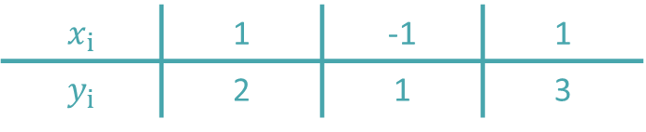


Example
$$x_{i}$$ | 1 | -1 | 1
$$y_{i}$$ | 2 | 1 | 3
$$y=1.75+0.75x$$
$$\text{SE}=0.5$$
Notes:
Plotting on a same figure our data points and the found linear model demonstrates that indeed our model fits the points.
Intuitively, from the figure, it is as well clear that the line we found is the best possible line we can choose t pass as good as we can through all data points.
Can you find the squared error SE?
The answer is 0.5.
This is the smallest possible squared error one can achieve.

Slide 19
Summary
Regression, or fitting, consist in choosing parameters of a model such that the model represent as good as possible the data
The difference between the model prediction and the data points is called a residual
The methodology of fitting a model to a set of data is to find the model parameters such that the measure of the residuals is as small as possible
A closed form solution was given for the case of a linear model
Notes:
Let us summarize the key findings
Regression, or fitting, consist in choosing parameters of a model such that the model represent as good as possible the data
The difference between the model prediction and the data points is called a residual
The methodology of fitting a model to a set of data is to find the model parameters such that the measure of the residuals is as small as possible
A closed form solution was given for the case of a linear model

